Slide 1
2025 Adult Inpatient Survey (IP25)
Trust Webinar 2
Thursday 13th Nov, 12:30pm – 2pm

Slide 2
Contents
Overview of 2025 Adult Inpatient Survey (IP25) [10 mins]
Potential sampling errors [5 mins]
Sampling and contact approach [15 mins]
Patient facing materials [10 mins]
Questionnaire development: survey questions [15 mins]
Data protection and Section 251 requirements [5 mins]
Demographic Batch Services (DBS) checks [5 mins]
Instruction manuals [10 mins]
Entering fieldwork [5 mins]
Key dates [5 mins]
Questions [5 mins]

Slide 3
Overview of 2025 Adult Inpatient Survey (IP25)

Slide 4
Overview of 2025 Adult Inpatient Survey (IP25)
Mixed mode approach
Mixed mode approach consisting of an 8-page paper questionnaire and a 15 minute online survey, was adopted in 2020 and continues to be the preferred approach for the survey each year.
Online survey options:
For in-house trusts: centralised online survey tool will be provided by the Survey Coordination Centre (SCC).
Approved contractors may provide their own online survey tool, if preferred. This should meet the NPSP wide specifications.
Contact approach remains the same as 2024 i.e. a mixture of postal and SMS contact.
Sampling criteria
Eligibility criteria remains the same as 2024: 16+ years or older and must have spent at least 1 night in an NHS hospital in November 2025.
Sampling variables
Sampling variables will remain the same as 2024 e.g. NHS number, full date of birth, virtual wards indicator.
Questionnaire updates
Updates following stakeholder consultations, focus groups and cognitive testing will be discussed. Please note that where possible, the 2025 survey will aim to keep trend data to allow for consistent tracking of changes in patient experiences over time.

Slide 5
Sampling and contact approach

Slide 6
Sampling: eligibility criteria (1)
For the 2024 Adult Inpatient Survey, there were several sampling errors noted around eligibility criteria such as age and virtual wards. The sampling materials have been updated to add extra clarity around eligibility criteria as below.
Eligibility criteria: age
Eligibility criteria remain the same as 2024: adult patients aged 16 years or older and must have spent at least 1 night in an NHS hospital in November 2025.
Patients need to be aged 16 years or older at the time they were admitted to hospital for their inpatient stay i.e. at the time of admission.
Patients who are aged 16 or over at the time of sampling, i.e. December 2025, but were 15 years old or younger at the time of admission to their inpatient stay, i.e. November 2025, or earlier if you are sampling back, ARE NOT ELIGIBLE for the survey.
Patients whose month of birth and year of birth fall after November 2009, ARE NOT ELIGIBLE for the survey.
Eligibility criteria: virtual wards
Virtual ward patients are eligible for the adult inpatient survey IF they have also had an inpatient stay and meet other survey criteria. If a patient has not stayed in a physical NHS hospital and have only been admitted directly to a virtual ward, they ARE NOT ELIGIBLE for the survey.
The discharge date recorded for virtual ward patients during sampling must be from their inpatient stay at a physical NHS hospital ward, not from their virtual ward stay.

Slide 7
Sampling: eligibility criteria (2)
Please do not include patients who:
Are aged younger than 16 years old at the time of admission to their inpatient hospital stay.
Deceased patients – identified via DBS and / or local checks.
Obstetrics / maternity patients, including spontaneous miscarriages.
Patients admitted for planned termination of pregnancy.
Psychiatry patients – identified via Treatment Function Codes.
Day case patients i.e. patients who arrive and leave on the same day – patients must have had an overnight stay where they were admitted and occupying a bed at midnight to be eligible.
Patients who have ONLY had a virtual ward stay but HAVE NOT been admitted to a physical NHS hospital ward.
Private patients and NHS patients treated at private hospitals.
If patients are currently an inpatient at the time of sampling.
Patients without a UK postal address – if addresses are incomplete but still usable, then patients can still be included.
Patients with addresses outside of the UK – British Islands patients are eligible, along with patients based at a military base, care homes, GP practice or a prison establishment.
Patients who have dissented or requested their details not be used for any other purpose outside of clinical care.
Patients who only spent time in a community hospital – if they did not have an inpatient stay in an acute hospital setting, they are not eligible. If they had both, please contact the SCC to confirm eligibility.

Slide 8
Sampling: instructions
The sample for the Adult Inpatient Survey is selected from adult patients aged 16 years or older at the time of admission.
You must select patients who were consecutively discharged from your trust, working back from the last day of November 2025, until your initial sample consists of 1,350 patients.
This will allow for the removal of some patients following checks e.g. deceased patients removed after DBS and local checks conducted.
If you think you may need to remove more than 100 patients, then you may select a larger initial sample e.g. 1,550 patients.
Once you have conducted your checks and removed ineligible patients, your final sample size MUST NOT EXCEED 1,250 patients.
For certain trusts, sampling back into prior months may be necessary to meet the final sample size of 1,250 patients. If you need to sample back:
You must inform your approved contractor and the SCC team via email.
You must not sample back further than 1 May 2025.
If you reach 1 May 2025 and still have not achieved the sample size of 1,250 patients, please submit the sample with the number of eligible patients that you have. Please confirm your final sample size with your approved contractor and the SCC team.
You must also detail the reason for not meeting the sample size of 1,250 in the sample declaration form at the relevant check, i.e. row 10 in the ‘Checklist’ tab, “Your sample consists of 1,250 eligible inpatients aged 16 years or over (at the time of admission).”
Specialist trusts who cannot meet this sample size must ensure their sample size is consistent with prior years. You must inform your approved
contractor and the SCC team as detailed above.

Slide 9
Contact approach
The contact approach will remain the same as the 2024 Adult Inpatient Survey (IP24).
Contact Type | Content | Example of mailing day
Postal – Day 0 | Aged 79 and under: push to web, letter containing online survey details & QR code. Aged 80+: letter containing online survey details & paper questionnaire. | Monday
SMS – Day 7 | 1st reminder sent to complete the paper questionnaire / online survey (if mobile number is available). | Monday
Postal – Day 14 | 2nd reminder – all ages sent a letter (no additional paper questionnaire provided). | Monday
SMS – Day 21 | 3rd reminder sent to complete the paper questionnaire / online survey (if mobile number is available). | Monday
Postal – Day 35 | Final reminder – all ages sent a letter and paper questionnaire. | Monday
Please ensure that DBS and local checks are provided in plenty of time to allow mailings to be sent on time.
Trusts will need to work alongside their approved contractors to agree on dates to complete these checks before the start of fieldwork.
DBS and local checks will be covered in additional detail soon.

Slide 10
Potential sampling errors

Slide 11
Sample errors and how to avoid them
Below are a list of checks that should be done before you submit your sample to your approved contractor or to the SCC:
Check the distribution of patient ages and patient gender in your sample; ensure patients are aged 16 or over at the time of admission.
Check the distribution of patient admission method.
Are there any errors in the query used to extract the eligible patient populations?
Are there any missing / incomplete data in your initial database?
Have the local checks for deceased patients / DBS been done correctly?
Be aware of system migrations.
Ensure patients on the national data opt-out programme are not excluded.
Ensure patients who have dissented to taking part are excluded.
Check all codes provided in your sample are valid.
Check admission dates are as expected.
Check admission and discharge sites are correct.
Ensure ICD-10 codes are present where possible.
Ensure patients have had an overnight stay on a ward in a physical NHS hospital. Patients with ONLY a virtual ward stay should be excluded.
For further information, please refer to the Sampling Instructions document on the NHS patient surveys website.

Slide 12
Sample Declaration Form
Completing the Sample Declaration Form can help avoid errors. Avoiding errors will ensure the fieldwork launch can happen earlier, and your data will be usable in this year’s survey. The Sample Declaration form includes:
Guidance tab
This includes information on how to complete the declaration form correctly. It’s recommended that this is reviewed ahead of completing the form.
Checklist tab
The “Comments about your trust” section MUST be completed – if there are no changes in your trust this year that could affect the comparability of your sample to last year e.g. trust merger, acquisitions / changes of services etc, then you can write “No changes” in this section. Do not leave this section blank.
All checks must be completed – if you have added “N/A” for a check, the “Comments” column MUST be completed. Missing information can cause delays to the approval of your sample.
If there are checks where you are unsure what information is required, please consult your approved contractor or the SCC team.
Declaration Agreement tab
This must be completed and signed by BOTH the individual who has drawn the sample for your trust AND your Caldicott Guardian.
The date the sample has been signed off by both individuals, along with email addresses and mobile phone numbers must also be added.
Missing information can delay the approval of your sample.
Submitting your Sample Declaration Form:
Sample declaration forms are to be submitted to your approved contractor (or the SCC team if you are an in-house trust).
Once the form has been approved, please submit your sample safely via the secure file transfer site.

Slide 13
Patient facing materials

Slide 14



Patient communication: updates
Minimal changes were made to the patient facing materials to improve clarity, following feedback from the IP24 survey, stakeholder consultations, ethics reviews by Picker and CQC, and cognitive interviews with patients conducted between September and October 2025.
Mailing letters:
Publication – information on publication timings added to the 2nd page on all mailing letters.
SMS invitation – a note was added to the first mailing letter to highlight that an SMS invitation may also be received to participate online.
Title - the patient’s title (Mr / Mrs / Miss / Ms) has been included in the salutations for instances where the patient’s first name is not available.
Other minor amends were made for formatting and slight wording changes for clarity.
SMS guidance:
Opt-out text added ‘Wish to opt out?’ to align wording with other patient surveys on the NPSP.
“Your survey ID” changed to “Your survey number” to align with wording included on other patient materials, e.g. mailing letters.
Multi-language sheet (MLS)
No changes have been made for the languages available for the 2025 Adult Inpatient Survey.
Patients will be able to access the translated online survey in the following 9 languages: Arabic, Bengali, French, Gujarati, Polish, Portuguese, Punjabi, Spanish and Urdu. BSL videos will also be provided for all questions for patients who require this.
Additionally, patients will be able to call a language line to access a translator, available in 22 languages.

Slide 15



Other survey materials: publicity toolkit
Outlines the purpose and value of the 2025 Adult Inpatient Survey for trusts.
Can be tailored to demonstrate how research findings have been used to identify areas of improvement and action change.
Provides information about the purpose, value and dates of the survey.
Includes: 4x social media cards, each with calls to action and signposting to find more information about the survey.
Can be shared on your social media platforms like Facebook or LinkedIn.
Used for promotion of the survey.
Banners are to be simple in content, with easily digestible information.
Banners can be added to websites, email signatures and any other platforms as appropriate.
Press release template
Social media cards
Website banner
Social media cards were reviewed during cognitive testing with patients and updated to improve emotional engagement, clarity around calls to action, and Section 251 information.
Publicity materials can be accessed via the NHS patient surveys website.

Slide 16



Accessibility options
As per previous iterations of the Adult Inpatient Survey, there are a variety of accessibility features available for the online survey and paper questionnaire to ensure all service users can complete the survey in line with their individual needs.
Via online survey
A A
Change font size
Change background colour
Screen reader compatible
Multiple language options
Questionnaires available in:
Large-print
Easy Read
Braille
Language Line:
Option to contact a telephone-assisted helpline to request help to complete the survey.
Help is available in approximately 22 languages.
Via contractors on request

Slide 17
Questionnaire development: survey questions

Slide 18
Development process for IP25
In line with previous iterations of the survey, this years’ survey will continue to use a mixed-mode methodology – online survey and paper questionnaire.
July – August 2025
September – October 2025
November 2025
December 2025
Desk research: to review recent policy
Discussion groups with NHS England & CQC Regulatory Leadership.
Focus groups with patients and frontline staff:
to explore updates to policies and areas of growing importance in inpatient care.
Second trust webinar: to discuss sampling process and questionnaire amendments for 2025.
Second contractor consultation: to discuss changes for the 2025 survey and sampling and fieldwork processes.
Preparation for fieldwork.
Trusts draw their sample.
Cognitive interviews with 18 patients to test patient facing materials: 90-minute virtual interviews with patients from various demographic backgrounds. Patients included those with carers and individual needs.
Advisory Group meeting, consultation with contractors, first trust webinar: to discuss learnings from 2024 and new areas for exploration in the 2025 survey.

Slide 19
Online survey: updates for 2025
Updates | Rationale
Introduction text: Additional text added “You don’t have to complete the survey on the same device (for example a phone, tablet or laptop), but you do have to use the same survey number and password to log in”. | Increased clarity regarding completing the survey on other devices, following patient feedback on uncertainty whether survey progress would be saved or deleted.
Q28 (individual needs) Matrix-style format changed to an “item-by-item – vertical scrolling” format. Question text is outlined at the top of the page, and each response option is listed sequentially below, e.g. Religious needs. Each response option has its own single choice options of “Yes, No, I did not need this”. | Question format changed to improve mobile-optimisation and improve data quality. New format will eliminate the need for horizontal scrolling, reducing likelihood of completion errors. Supported by literature on optimal survey designs for mobile completion.
Q51 (age) Hard check validation removed. Soft check validation added to encourage patients to enter the correct year of birth (YoB). Patients can proceed with no amend to their answer or with no answer entered. | Implemented following previous errors on other surveys with hard check validation. New process expected to allow for a smoother survey completion experience.

Slide 20
Questions updated for 2025
Updates | Rationale
Q28 (individual needs) “Thinking about your care and treatment, did hospital staff take into account the following individual needs”. New response option added “Mental health needs, e.g. a quiet space, emotional support”. Q33 (involvement of family and carers during discharge) “To what extent did hospital staff involve your family or carers in decisions about you leaving the hospital”. Wording changed from “discussions” to “decisions”. Q38 (information provided to family and carers during discharge) “Before you left the hospital, were your family or carers given the information they needed to care for you at home?”. New question for IP25. Q48 (long-term conditions) “Do you have any of the following physical or mental health conditions, disabilities or illnesses that have lasted or are expected to last 12 months or more?”. New response option added “Neurodivergence (other than autism or autism spectrum condition)”; response option 18 changed to “I do not have any long-term conditions”, was previously “None of the above”. | Q28: new response option added following feedback from patients during cognitive interviews and positive testing. Q33: wording updated following stakeholder discussions on importance of inclusion of carers and family members in decisions about discharge processes on patient outcomes. Q33 (previously Q36 for IP24) will be treated as a new question for IP25, no trend data will be available for this year. Q38: new question added for IP25 following stakeholder discussions on importance of inclusion of carers and family members in discharge processes and impact on patient outcomes. This question tested well during cognitive testing, most patients reported this to be an important topic to address. No trend data will be available for this year. Q48: New response option added following discussions with CQC along with amendment to existing response option 18. No trend data available for these options for this year.

Slide 21
Questions removed for 2025
Updates | Rationale
Q7 (length of time in waiting location) “Thinking about the location(s) selected at Q6, how long did you wait, in total, before you were admitted onto a ward?”. Q9 (changing wards during the night) “Did you ever change wards during the night?”. Q10 (reasons explained for changing wards) “Did the hospital staff explain the reasons for changing wards during the night in a way you could understand?”. Q36 (family and carer involvement in discussions about leaving hospital) “To what extent did hospital staff involve your family or carers in discussions about you leaving the hospital?”. | All questions removed following discussions with stakeholders on priority areas for the 2025 Adult Inpatient Survey. Stakeholder feedback noted that data for changing wards during the night is recorded in trust systems as it happens throughout the year and was found to be more useful for service decisions vs data collected from the inpatient survey once per year. Q36 replaced by Q33 to capture involvement in “decisions” about leaving hospital (see prior slide).

Slide 22
Data protection and Section 251 requirements

Slide 23
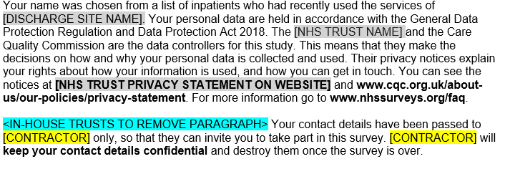
General Data Protection Regulation (GDPR) & National Data Opt-Out Programme
National Data Opt-Out Programme
General data protection regulation (GDPR)
NPSP has received exemption from the National Data Opt-out Programme.
How patients’ personal data is being protected under the GDPR is stated on the reverse side of the covering letter for mailings 1-3:
We will continue to have separate opt-out mechanisms via the dissent posters that need to be displayed across all trusts.
Please note that patients do not have to actively consent to the sharing of their data, for the 2025 Adult Inpatient Survey.

Slide 24
Section 251 requirements
We ask that you publicise the survey both internally and externally to ensure patients are aware of the survey and can opt-out should they wish.
Publicity materials (press release template, social media cards, website banner) will be available to download for use on the NHS patient surveys website.
Dissent posters are also now available in the following languages on the NHS patient surveys website:
Arabic, Bengali, Bulgarian, Dari, Farsi / Pashto, French, Gujarati, Indian Punjabi, Italian, Kurdish Sorani, Lithuanian, Nepali, Polish, Portuguese, Romanian, Russian, Simplified Chinese, Somali, Spanish, Tamil, Traditional Chinese, Turkish, Ukrainian, Urdu.
These also provide patients with the opportunity to opt out of the survey, should they wish to do so.
Dissent posters MUST be displayed in all trusts for the duration of November 2025 to comply with Section 251 requirements.
Ensure an accurate log of patients who have dissented from taking part in the survey is kept.
Ensure the total number of eligible patients who have dissented from the sharing of their details for any purpose other than their clinical care or who have dissented from taking part in the survey specifically are recorded in your Sample Declaration Form and are excluded from your sample.

Slide 25
Demographic Batch Service (DBS) checks

Slide 26
DBS checks
A minor amend has been made to the process of conducting DBS and local checks for the 2025 Adult Inpatient Survey.
What has changed:
DBS and local checks were previously required if it had been more than 2 weeks (10 working days) between the time of the sample being drawn and the first mailing. This has now been adjusted to offer greater flexibility to trusts and contractors.
Going forwards, trusts will have the choice to conduct a DBS check and / or a local check if it has been more than 2 weeks between the time of the sample being drawn and the first mailing being sent. One of these checks MUST be done but both are not necessary.
Trusts and contractors will need to discuss and agree which checks will be conducted (both or just one) and who will be responsible for conducting the checks.
What remains the same:
First checks are completed when the initial samples are drawn by the trusts. Trusts must conduct both a DBS check AND a local check on the initial sample of 1,350 patients.
After first checks, and upon agreement with the trust, contractors can conduct DBS checks on trusts’ behalf; this includes DBS checks prior to the first mailing and in between each mailing.
DBS and / or local checks must be run prior to the second mailing and third mailing to avoid sending reminders to patients who have died in between mailings.
Drawing sample
DBS check required
Local check required
Mailing 1
If >2 weeks has passed since first checks made:
DBS check and / or local check
Mailing 2
DBS check and / or local check
Mailing 3
DBS check and / or local check

Slide 27
Instruction manuals

Slide 28
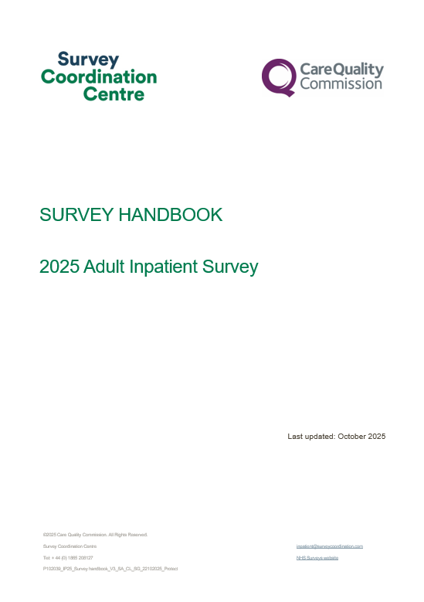

Survey Handbook
For survey leads:
Document outlining step-by-step process for preparing and running the survey.
It is a key summary document that links to all other relevant information regarding the survey handbook.
Includes:
What’s new for the 2025 Adult Inpatient Survey (including updated specifications for the online survey tool).
Tips on managing and implementing the survey.
Key dates: top level.
Highlights on key information e.g. Section 251.
This is available for download from the NHS patient surveys website.

Slide 29
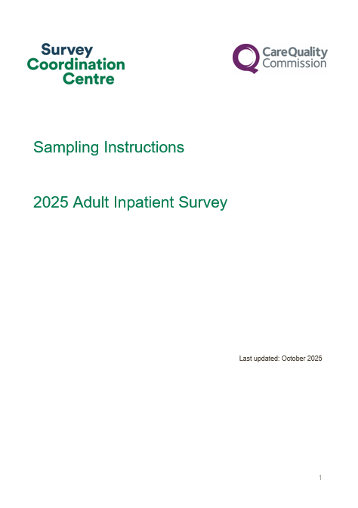
Sampling Instructions
For sample drawers (data team):
Document outlining step-by-step process for how to draw your sample.
Key summary document that links to all other relevant information regarding survey sampling.
Includes:
Overview of the sample drawing process.
Details on eligible and ineligible patients.
Information on DBS and local checks for deceased patients.
Checking and submitting your sample.
This is available for download from the NHS patient surveys website.

Slide 30
Other documents
Sample Construction Worksheet
To be used to construct the sample of eligible patients for the survey.
Two versions will be available depending on whether you will be using the SCC centralised tool.
Each version will contain all relevant fields for the sample details, mailing details and fieldwork variables.
Please contact your approved contractor or the SCC team if you are unsure what information is required for the worksheet or have any queries.
Sample Declaration forms
To be used to check your sample has been correctly drawn before submission to your contractor or the SCC team.
Two versions will be available depending on whether you will be using an approved contractor to conduct fieldwork on your behalf or conducting the survey in-house.
Includes:
Instructions on how to complete the form
Checklist for checks that must be completed for your sample
Declaration agreement to be completed and signed by both the sample drawer and the Caldicott Guardian prior to submission of the sample.
Please note that any errors or missing information in the sample declaration form may delay approval of your sample.
If you have any queries about the information required or are uncertain how to complete any of the checks, please contact your approved contractor or the SCC team.
This is available for download from the NHS patient surveys website.

Slide 31
Useful NPSP instruction documents
Other instructional documents that are useful for implementing the 2025 Adult Inpatient Survey can be found on the NHS Surveys website:
Patient feedback and the NHS Constitution
Setting up a project team
Data protection and confidentiality
Ethical issues, ethical committees and research governance
Collecting data from non-English speaking populations
Publicising the survey
Implementing the survey – practicalities
Submitting samples
Entering and submitting final data
Making sense of the data
Reporting results
Universal glossary

Slide 32
Entering fieldwork

Slide 33
Entering fieldwork early / on time
Entering fieldwork on time or earlier will help your trust to maximise responses from minority ethnic groups. You will also likely receive an overall higher response rate, providing your trust with more data.
Ensure you have a survey team in place before you start drawing your sample.
Generate your sample promptly - begin preparing now.
Respond to queries as soon as possible to avoid unnecessary delays.
Ensure there is sufficient resourcing around the time of drawing your sample and answering queries – communicate with your team, handover tasks if people are going to be on leave and let your contractor and the SCC know of any updates.
If there are any changes in the survey lead, inform your contractor and the Survey Coordination Centre (SCC) via email.

Slide 34
Key dates

Slide 35
Key dates
More detailed timelines can be found in the 2025 Adult Inpatient Survey handbook for trusts managing sampling in-house and for those using an approved contractor.
The survey handbook is available for download from the NHS patient surveys website.
Activity | Date
Dissent posters to be displayed (available on the NHS patient surveys website) | 15th September 2025 – 30th November 2025
Publication of sampling materials (following section 251 approval) | Tuesday 4th November 2025
Publication of patient facing materials (following section 251 approval) | Tuesday 4th November 2025
Samples drawn by trusts | Monday 1st December 2025 – Friday 2nd January 2026
Submit sample to contractor | TBC by contractors
Submit sample to SCC [for trusts delivering survey in-house only] | Friday 2nd January 2026
Sample checking (SCC) | Monday 15th December 2025 – Wednesday 21st January 2026
Fieldwork (15 weeks) | Monday 19th January 2026 – Monday 20th April 2026

Slide 36
Any other points for discussion?

Slide 37
If you have any further thoughts or queries, please contact us at inpatient@surveycoordination.com

